Slide 1
Theme 7: key terms

Slide 2
LEARNING GOALS
To provide an overview of the key terms in theme 7
Covenant
The Law or Torah
Prophets
Chosen People
Revelation

Slide 3
Theme 7: key terms
Chosen People – not so much a privilege as a mission. They were a “summoned” people that were called to live the revelation of God to their ancestors for all the world to see and hear.
This video provides a quick overview of the history behind the chosen people!

Slide 4
Theme 7: key terms
Prophets: Holy persons from Israel who were spokespersons for God. Because they were close to God through prayer, they could communicate God’s words through oracles, visions, judgement, and symbolic actions.
Here is a great summary video on what a prophet is!

Slide 5
Theme 7: key terms
Revelation – God communicates God’s-self in stages: through creation itself, through covenants and through prophets. God’s self-revelation is complete in Jesus and is passed on to all generations through the sacred Scriptures and apostolic tradition.

Slide 6
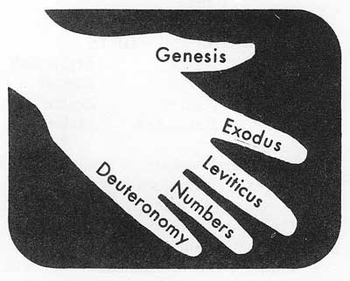
Theme 7: key terms
The Law or Torah – the heart of the Old Testament; God’s instruction about the covenant: how to live in the mutually agreed-upon relationship with God. The Ten Words (Ten Commandments) are the code of the covenant.

Slide 7
Theme 7: key terms
Bar Mitzvah (for boys)/Bat Mitzvah (for girls) – usually celebrated when the young person is about 13 years old. The Torah is passed symbolically from one generation to another, giving them personal responsibility for Jewish teachings.

