Slide 1
Habit #4
Think Win-Win

Slide 2
Habit #4: Think Win-Win
Win-Win is an attitude toward life; a mental frame of mind that syas, I can win and so can you
It is not about me or you, it is about both of us
It begins with the belief that we are all equal, that no one is inferior or superior to anyone else and not needs to be the winner
Life is not all about the competition, the way it may bei n business, sports and/or school

Slide 3
Two major blocks to the Win-Win attitude are:
Competition
Comparing
Can be extremely healthy
Drives us to improve
Without it you would never know how far you can push yourself
Becomes dark when you tie your self-worth to winning or when you use it to place yourself above another
Comparing yourself to others is nothing but bad news
We are all on different developmental timetables
You end up feeling inferior one moment and superior the next

Slide 4
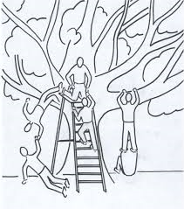
Win-Lose: The Totem Pole
Full of pride
Try to get ahead at the expense of others
Always insist on getting your way without considering the feelings of others
Become jealous and envious when something good happens to someone close to you

Slide 5
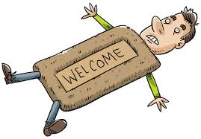
Lose-Win: The Doormat
Looks good on the surface, but is just as dangerous was Win-Lose
Weak and easily gets stepped on
It is easy to be the nice person and give in all the time in the name of being a peacemaker
You will find yourself setting low expectations and compromising your standards
Fin when the issue is not important to you, but can cause serious damage when the issue is important

Slide 6
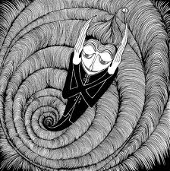
Lose-Lose: The Downward Spiral
“If I’m going down, then you are going down with me, sucker!”
War is a great example
Usually happens when two Win-Lose people get together
If you both want to win at all costs, than you are both to lose

Slide 7
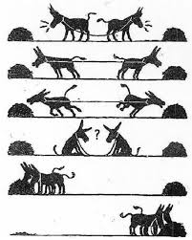
Win-Win: The All-You-Can-Eat-Buffet
Belief that everyone can win
Nice and tough at the same time
You care about others, but want to succeed as well
Plenty of success to go around

Slide 8
Habit #4: Think Win-Win Assignment
Pinpoint two area of your life in which you most struggle with comparisons. Perhaps it is with cloths, physical features, friends or talents. Explain why you feel the need to compare, and what you could possibly do to minimize the need to compare yourself.
Think about your general attitude toward life. It is based on Win-Lose, Lose-Win, Lose-Lose, or Win-Win? How is that attidue affecting you, your life and your happiness?
Are you in a Lose-Win relationship with anyone? If you are outline what you can to make the relationship Win-Win? If that does not happen, is the relationship worth taking the abuse?
If you are not in a Lose-Win relationship what choices have to made to avoid this? What steps can you take prevent a Lose-Win relationship in the future?

