Slide 1
Habit #5
Seek First to understand, then to be understood

Slide 2
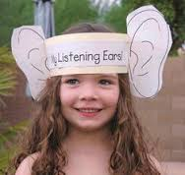
“Before I can walk in another’s shoes, I must first remove my own.” (Unknown)
It is our tendency to want to solve everyone’s problems before we even understand what the problem is. We simply do not listen.
Someone who seeks first to understand, then to be understood, listens first and talks second. This habit includes seeing things form another’s point of view before sharing your own.
This habit is the key to communication because the deepest need of the human heart is to be understood. People will not expose their inner selves unless they fell genuine live and understanding. Once they fell it, they may tell you even more than you want to hear.

Slide 3
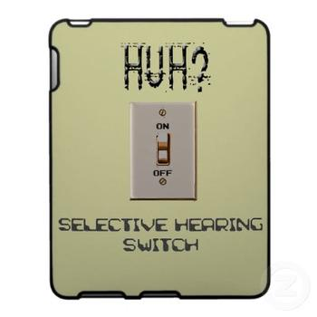
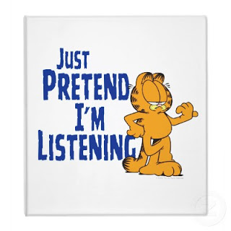
When people talk we seldom listen because we are usually too busy preparing a response, judging, or filtering their words through our own paradigms.
It is typical of people to use one the these Five Poor Listening Styles:
Spacing Out: When someone is talking we ignore them because we are caught up in our own thoughts
Pretend Listening: this is more common. We pretend we are listening by making comments like, “yeah”, “cool”, and “uh-huh”.
Selective Listening: We pay attention to only part of the conversation that interests us.

Slide 4
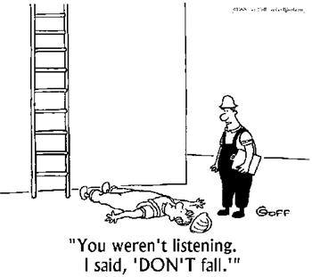
Word Listening: Occurs when we actually pay attention to what the person is saying, but we listen only to words, not the body language, the feeling, or the true meaning behind the words.
Self-centered Listening: We see everything from our own point of view. For example, “You think your day was bad, you should hear what happened to me.” The result is that the person immediately closes up.

Slide 5
Now that you have learned how to understand the other, you can seek to be understood.
When you give feedback to someone and/or express yourself, consider the following:
Is me feedback going to help this person or am I doing it just to suit myself?
Send “I” messages instead of “you” messages.

Slide 6
Habit #5 Reflection Questions
What is your relationship like with your parents?
Do you think you parent(s)/guardian(s) understand you? Explain.
Do you think you understand your parents (s)/guardians? Explain.
What are the benefits of taking time to understand and listen to your parents(s)/guardian(s)?
How can you better understand your parent(s)/guardian(s)?

Slide 7
Habit #6
Synergize

Slide 8
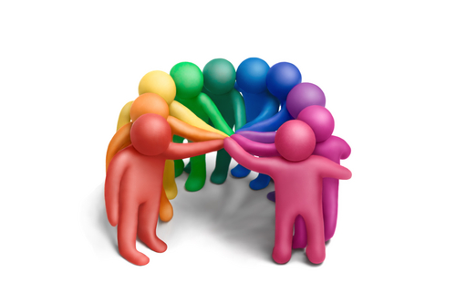
“Alone we can do so little; together we can do so much.” Helen Keller
What does “synergize” mean? Synergy is achieved when two or more people work together to create a better solution that either could alone. It is not your way or my way but a better way, a higher way.
Synergy is creative co-operation, with an emphasis on the word creative. The whole is greater than the sum of the parts.

Slide 9
Synergy
Synergy is:
Synergy is Not:
Celebrating difference
Teamwork
Open-mindedness
Finding new and better ways
Tolerating differences
Working independently
Thinking your always right
compromise

Slide 10
Synergy is Everywhere
The Sequoia Tree (which grow to heights of 300 feet or more) grow in clumps and share a vast array of intermingled roots.
Without each other, they would blow over in a storm.

Slide 11
Synergy is About Celebrating Diversity
This includes differences in culture, race, gender, physical features, dress, language, wealth, family ,religion, lifestyle, education, interests, skills, age, style, etc.

Slide 12
Roadblocks to Celebrating Differences
Ignorance: You are clueless. You do not know what other people believe, how they feel, or what they have been through.
Cliques: When your group of friends becomes so exclusive that they begin to reject anyone who is not just like them
Prejudice: Not something we are born with, rather something that we learn. This is when we pre-judge someone based on their skin colour, religion, gender, language, etc.

Slide 13
Habit #7
Sharpen the saw

Slide 14
Habit #7
Habit # 7 is all about keeping your personal self sharp so that you can better deal with life.
It means regularly renewing and strengthening the four key dimensions of your life, your body, your brain, your heart, and your soul

Slide 15
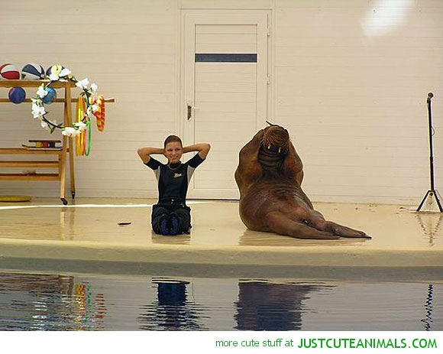
Body
The Physical Dimension
Exercise
Eat healthy
Sleep well
Relax

Slide 16
Brain
The Mental Dimension
Read
Educate
Write
Learn new skills

Slide 17
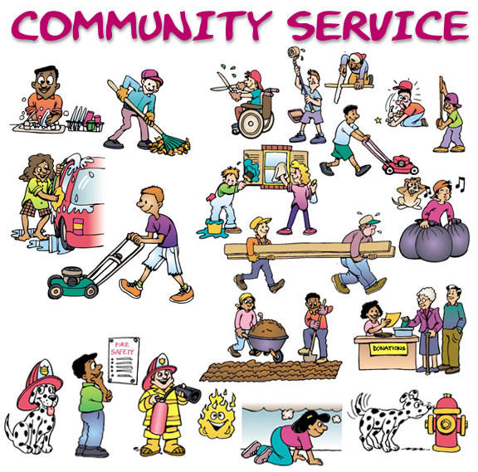
Heart
The Emotional Dimension:
Build relationships
Give service
Laugh

Slide 18
Soul
The Spiritual Dimension
Meditate
Keep a journal
Pray
Take in quality media

Slide 19
Why is balance so important?
It is because how you do in one dimension of life will affect the other three.
For example, it is hard to be friendly (heart) when you are exhausted (body).
Also, when you are feeling motivated and in tune with yourself (soul), it is easier to focus on your studies (mind) and then be more friendly (heart)

