Slide 1
Values

Slide 2
Robert Frost: The Road Not taken (1915)
Two roads diverged in a yellow wood, And sorry I could not travel both And be one traveler, long I stood And looked down one as far as I could To where it bent in the undergrowth; Then took the other, as just as fair, And having perhaps the better claim Because it was grassy and wanted wear, Though as for that the passing there Had worn them really about the same,
And both that morning equally lay In leaves no step had trodden black. Oh, I kept the first for another day! Yet knowing how way leads on to way I doubted if I should ever come back. I shall be telling this with a sigh Somewhere ages and ages hence: Two roads diverged in a wood, and I, I took the one less traveled by, And that has made all the difference.

Slide 3
Personal Values Inventory response
Choose you three highest values scores according to the sheet. Do you agree or disagree with each of these results? Why? How do each of these values influence your life. (minimum 150 words, to the second hole on the page)

Slide 4
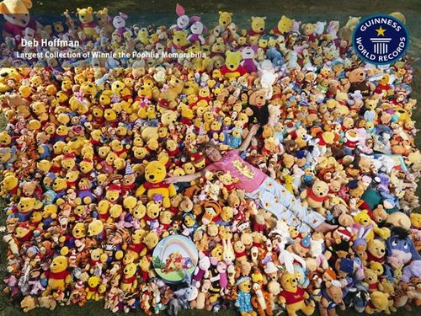
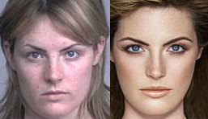
The Seven Classifications of Values
Moral Value- What you will or will not do simply because you believe it to be right or wrong. What is right or wrong; thoughts or codes by which to live.
Material Value- Material values reflect the possessions we own; the things on which we spend out money
Aesthetic values- Values that reflect your feelings about what has beauty in nature and life. They reveal appreciation for the way things look, sound, feel, taste, and smell.

Slide 5
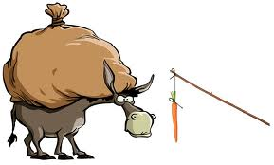
The Seven Classifications of Values continued…
Intrinsic values- Intrinsic values are things or ideas that have value to us in their own right; the end and not the means. For example, a friend has intrinsic value because of his/her character and personality.
Extrinsic values- some values are important because they help us gain other values or desired results. For example, you value one friend because the friend can help you be popular.

Slide 6
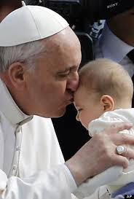
The Seven Classifications of Values continued…
Universal values- Universal values are values on which all or most people agree, such as equality, justice, worldwide brotherhood, respect of self, and others.
Group specific values- Group specific values are those that differ from state to state or region to region. For example, most North Americans value time and are always in a hurry; Europeans value people and spend time talking.

Slide 7
FACTORS WHICH AFFECT OUR PERCEPTION

Slide 8
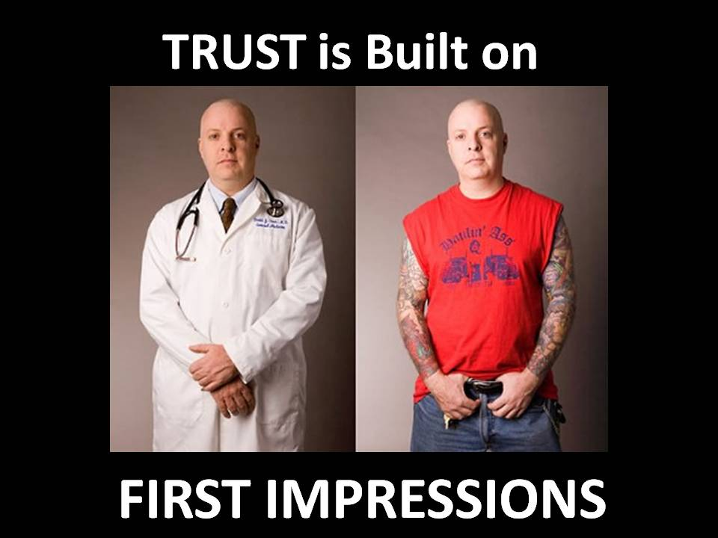
FIRST IMPRESSIONS
First impressions often have a powerful influence on how we perceive (see) people and events. They often determine the way we think or behave in a certain situation.

Slide 9
PERCEIVER’S ROLE (PERSONALITY)
Our personalities contribute to our expectations in life, our understanding of things, events and people, and out reactions to these situations.
E.G. A person who thinks they are stupid will approach a difficult class differently from someone who doesn’t think of themselves that way.

Slide 10
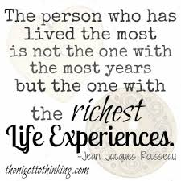
LIFE EXPERIENCES
These experiences teach us how to think and act towards people and events.

Slide 11
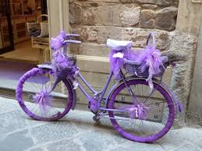
OBJECT OF PERCEPTION
Some things in our environment attract our attention.
E.G. Walk into a room and notice a beautiful person and not notice what the room looks like.
E.G. Notice a moving car in a parking lot, but not the parked ones.

Slide 12
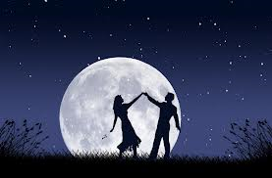
BACKGROUND AND SURROUNDINGS
Dancing under a full moon may be difficult than dancing in daylight in terms of romance.

Slide 13
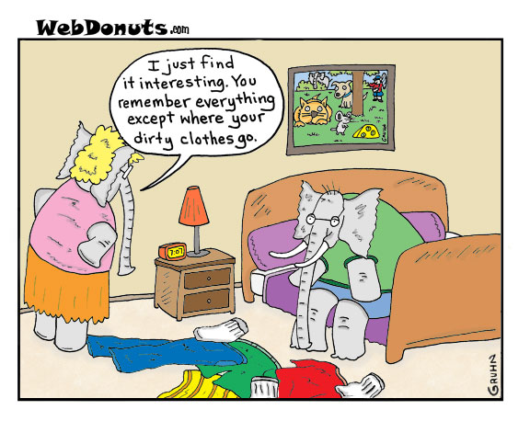
SELECTIVE MEMORY
We choose to remember certain things and block out others that we find unpleasant.

